Slide 1
Managing Permissions and Ownership
Modify File and Directory Permissions
Modify File and Directory Ownership
Configure Special Permissions and Attributes
Troubleshoot Permissions Issues

Slide 2

Topic A: Modify File and Directory Permissions
Exam Objectives:
3.1 Given a scenario, apply or acquire the appropriate user and/or group permissions and ownership.

Slide 3
Permissions
Access rights assigned to users, which enable them to access or modify certain files and directories.
Can be set at different levels and for different access contexts.
Enable you to configure who can and can't access an object.
Controlling access through permissions mitigates risk.
Users only have access to what they need, and no more.

Slide 4
Permission Attributes
Attribute | Description
Read (r) | Files: Access and view contents of a file. Directories: List contents of directory.
Write (w) | Files: Save changes to a file. Directories: Create, rename, delete files in directory (requires execute).
Execute (x) | Files: Run a software file. Directories: Access directory, execute file from directory, perform task on directory.

Slide 5
Permission Contexts
Permission attributes apply to one of several contexts.
The types of users/entities to give permission to.
Contexts:
Owner (u)
Also called user.
Group (g)
Members of object's group.
Other (o)
All other users.

Slide 6
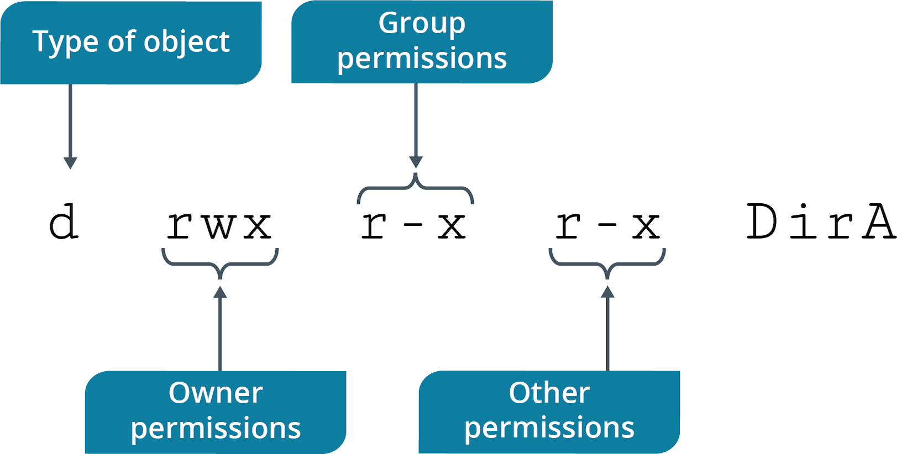
Permission String
Notes:
Teaching Tip: SELinux will be discussed in a later lesson.

Slide 7
The chmod Command
Enables you to modify permissions on files/directories.
Can only be done by owner of object or sysadmin.
Notes:
Teaching Tip: Consider pointing out that ownership will be discussed in further depth in the next topic.

Slide 8
chmod Command Options
Option | Used To
-c | Report changes made to permissions.
-f | Hide most error messages.
-v | Display diagnostic entry for every object processed.
-R | Modify permissions recursively.

Slide 9
chmod Symbolic Mode (Slide 1 of 2)
Set permissions using three components:
Contexts
Operators
Attributes
Operators:
+ grants permissions.
- denies permissions.
= assigns permissions exactly as provided.
Notes:
Teaching Tip: Inform students that they need to know both modes for the exam.

Slide 10
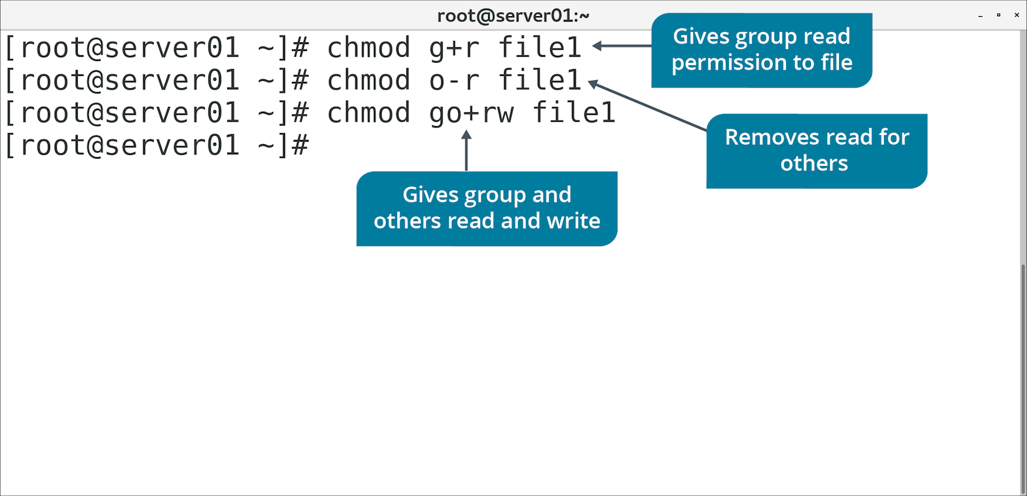
chmod Symbolic Mode (Slide 2 of 2)

Slide 11
chmod Absolute Mode (Slide 1 of 2)
Uses octal numbers.
4 = read
2 = write
1 = execute
Add numbers of permissions you wish to grant.
Sum of these is what you provide.
Read, write, execute is 7 (4 + 2 + 1).
Read, write is 6 (4 + 2).
Complete permissions are expressed as three-digit number.
Each digit corresponds to a context (owner, group, other).

Slide 12
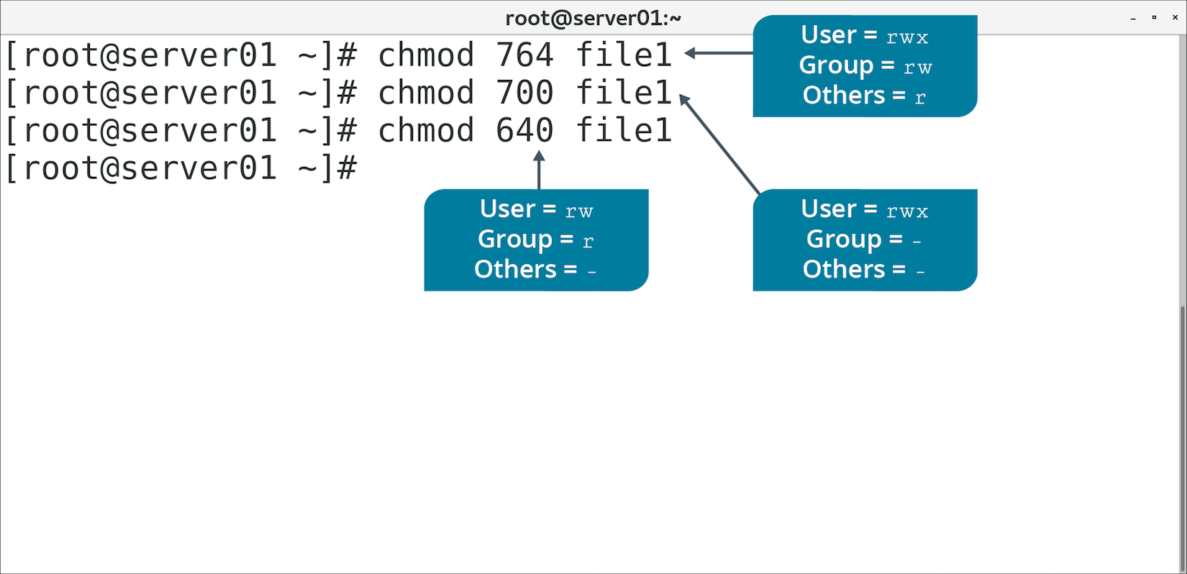
chmod Absolute Mode (Slide 2 of 2)

Slide 13
Activity: Modifying File and Directory Permissions
You're concerned about protecting files on a Linux server.
You'll configure permissions for file owner, group, and other users.

Slide 14
Default Permissions
Assigned to newly created files and directories based on user privileges.
Files created by root user are 644 (rw-r--r--).
Directories created by root user are 755 (rwxr-xr-x).
Files created by regular users are 664 (rw-rw-r--).
Directories created by regular users are 775 (rwxrwxr-x).
Default permissions determined by umask.

Slide 15
The umask Command (Slide 1 of 2)
Alters default permissions on newly created files/folders.
Can be useful for automating custom permissions for new objects.
You set default permissions using octal numeric format.
Specify permissions to mask, not to grant.
Default permissions for non-executable files are 0666
You want owner to retain permissions, but group and others to only have read.
The umask will be 0022
Each number explained:
0 means no advanced permissions set by default.
0 retains current owner permissions (no mask).
2 masks the default of 6, leaving 4 (read only) for the group.
2 does the same, but for others.
Can be set for session or per-user (in .bashrc).

Slide 16
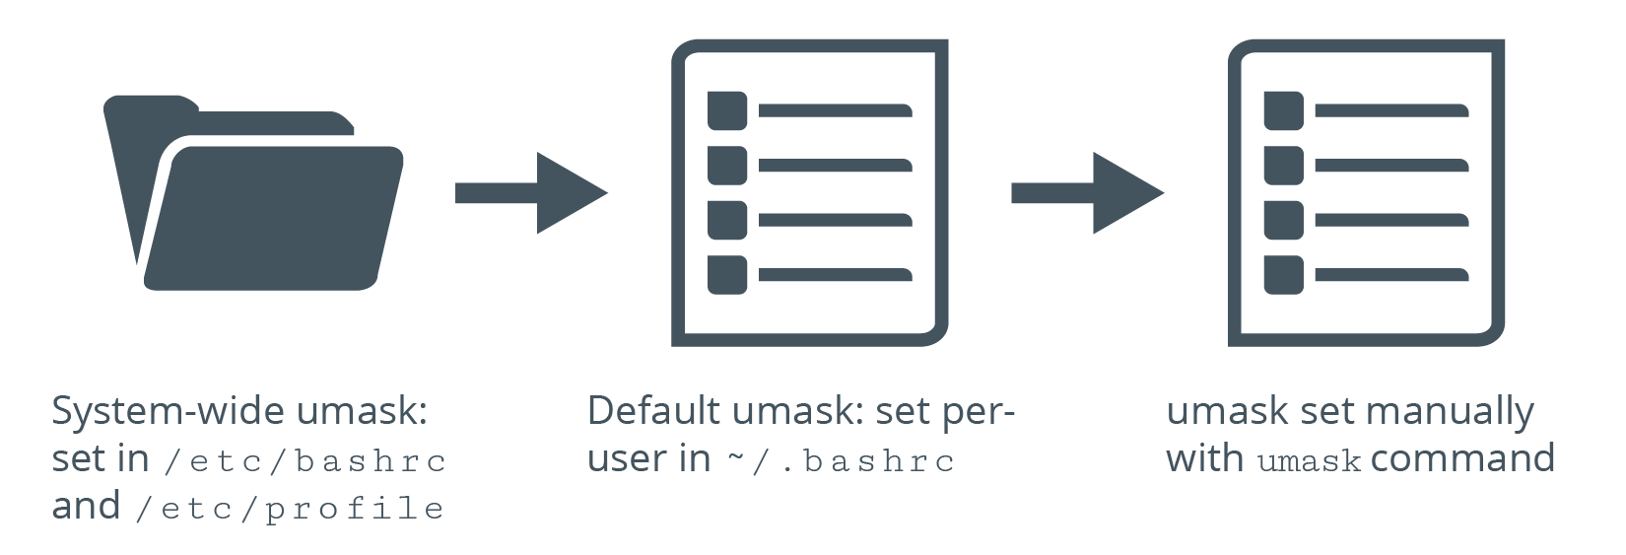
The umask Command (Slide 2 of 2)

Slide 17
Discussing File and Directory Permissions

Slide 18
Activity 3-2: Discussing File and Directory Permissions
Multiple users have complained about file access in a shared directory, but you've checked your daily backup reports and there are no corrupt files. Which command can you issue in the directory in question to investigate the problem further?
ANSWER:
ls -l —This command displays the permissions of all files in the directory to help you sort out the problem. It's likely that the directory's group permissions are incorrectly set.

Slide 19
Activity 3-2: Discussing File and Directory Permissions
A group of system administrators were discussing file permissions and decided that setting a particular root-owned text file to read-only for everyone is a best practice. What do the permissions for this file look like?
ANSWER:
Either 664 or rw-rw-r-- is correct.

Slide 20
Activity 3-2: Discussing File and Directory Permissions
A user cannot execute a script (collect.sh) she created and has sent you the contents of the script via email to inspect. After looking at the script, you determine the script is correctly written but permissions are the problem. What command can you issue to adjust the file's permissions as necessary?
ANSWER:
chmod u+x collect.sh

Slide 21
Activity 3-2: Discussing File and Directory Permissions
A user changed the permissions of a script (myscript.sh) in a shared directory. The user is curious why everyone can execute the script if the user owns the script and everyone else only has read access. To make the script executable, what command did the user mistakenly issue?
ANSWER:
chmod +x myscript.sh —The permissions changed to rwxrwxr-x or 775, which gives everyone execute permission. To limit execute permission to the user and group only, the command should have been: chmod ug+x myscript.sh

Slide 22
Activity 3-2: Discussing File and Directory Permissions
Your team lead is tired of receiving help desk tickets to restore deleted files from a directory that contains hundreds of files and subdirectories. She decides to have you fix the problem by making all of the files read-only. How do you change all the files to read-only without having to traverse each directory?
ANSWER:
chmod -R 644 * —This command changes all files in the current directory to 644 recursively.

Slide 23
Activity: Modifying Default Permissions
Chris Mason wants to create files with non-default permissions.
Will be able to share them more easily with co-worker.
You'll implement the change for Chris.

Slide 24
Topic B: Modify File and Directory Ownership
Exam Objectives:
3.1 Given a scenario, apply or acquire the appropriate user and/or group permissions and ownership.

Slide 25
Ownership
The property by which a user can apply and modify the permissions of a file or directory.
First permission context is owner.
By default, owner is the user who created the object.
No other user can modify permissions (except root).
Owner usually changes r/w/x permissions.
Owner can also change advanced/special permissions.

Slide 26
The chown Command
Changes owner, group, or both for a file or directory.
You may want other users besides the creator to manage permissions of an object.
chown {user name} {file/directory name}
Change owner.
chown {user name}:{group name} {file/directory name}
Change owner and group.
chown {user name}: {file/directory name}
Change owner, and change group to specified user's login group.
chown :{group name} {file/directory name}
Change group.

Slide 27
The chgrp Command
Changes group ownership of a file or directory.
Useful for applying permissions to a group.

Slide 28
Discussing File and Directory Ownership

Slide 29
Activity 3-4: Discussing File and Directory Ownership
A user (Bob Smith—username: bsmith) calls you to request that you restore a group of files he accidentally deleted from his home directory. You copy the files for him but he later complains that he can no longer edit the files. What do you need to do so that he can edit his files?
ANSWER:
You need to change ownership of the files to him. Change user and group ownership recursively so that Bob owns all files and directories. For example: sudo chown -R bsmith:bsmith *

Slide 30
Activity 3-4: Discussing File and Directory Ownership
Gina wants to share some marketing files with two other members of her team but doesn't want them to access those files in her home directory. She also wants the directory and its files to only be available to the Marketing group. What steps can you take as an administrator to accomplish this request?
ANSWER:
1) You need to create a new group (mkt): sudo groupadd mkt 2) Add users to the group: sudo usermod -aG mkt gina linda mark 3) Create the shared directory: sudo mkdir /opt/marketing 4) Change group ownership to mkt: sudo chgrp mkt /opt/marketing 5) Change permissions so that the Marketing group has full control of the directory and its contents and remove everyone else: sudo chmod 770 /opt/marketing

Slide 31
Activity 3-4: Discussing File and Directory Ownership
What command is equivalent to issuing chown :mygrp file1?
ANSWER:
chgrp mygrp file1 —Both commands change the file's group to mygrp without changing the owner.

Slide 32
Activity 3-4: Discussing File and Directory Ownership
As an administrator, you've created a shared directory and made the necessary permissions changes to allow a group of users access to that directory. You've also added users to the group. When a user (susan) who is a member of the group creates a file in the shared directory, what user and group permissions will the new file have?
ANSWER:
The file's user and group ownership will both be susan.

Slide 33
Activity 3-4: Discussing File and Directory Ownership
What must a user do in a shared directory to ensure that each group member has full read and write access to files they create?
ANSWER:
Change the group ownership to the group: chgrp accounting salaries.txt —The user doesn't have to be root or use sudo to change group ownership because the file creator is the file's user and group owner, and therefore may change its permissions at will.

Slide 34
Activity: Modifying File and Directory Ownership
You'll create a Graphics department directory.
Members can store content here.
You'll configure ownership and group associations for directory and files.

Slide 35
Topic C: Configure Special Permissions and Attributes
Exam Objectives:
3.1 Given a scenario, apply or acquire the appropriate user and/or group permissions and ownership.

Slide 36
Special Permissions
Used when normal permissions are inadequate.
Less privileged users execute file by assuming privileges of file's owner/group.
Enables user to assume high-level privileges in a limited context.

Slide 37
SUID and SGID Permissions
SUID/SGID: The permissions that allow a user to assume the file owner's/group's privileges.
SUID: Certain executables require access to additional resources.
User may not have explicit permission to these.
The passwd command is configured so users will execute it as root (owner).
Gives user permission to access additional resources.
SGID can also be set on directories.
Subdirectories inherit SGID permission.
New files/subdirectories inherit directory's group ID, not group ID of creator.
Inheritance is useful in shared environments.
Users don't need to change groups when creating objects.
SGID doesn't apply to existing or moved objects.
Use chmod to set either SUID or SGID.
Look for s permission when using ls –al command.

Slide 38
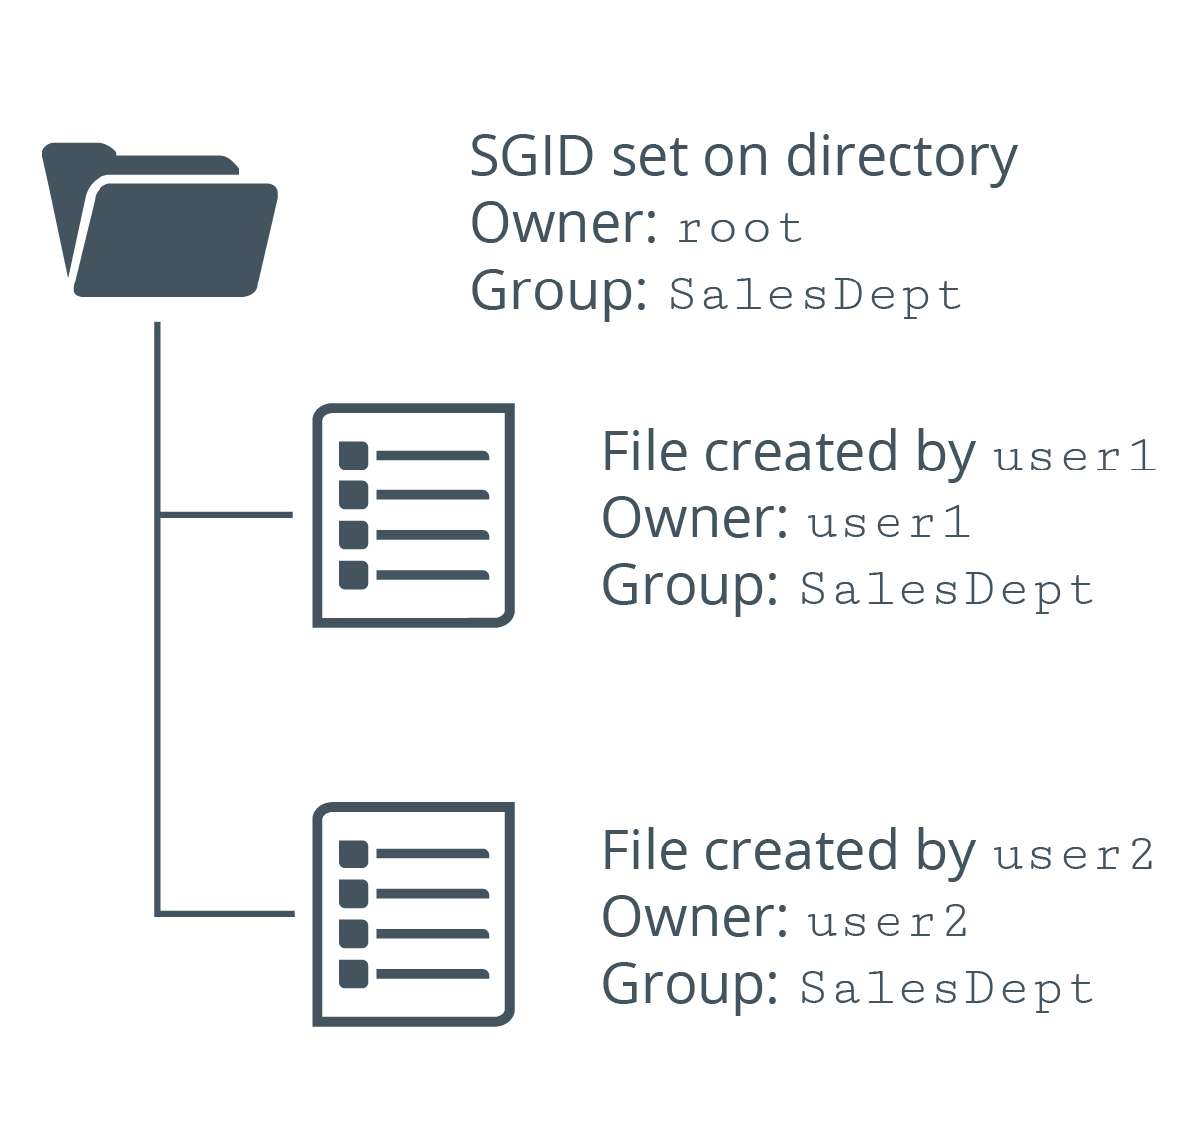
Example of SGID

Slide 39
Sticky Bit
A special permission bit that provides protection for files in a directory.
Only owner or root can delete the object.
Otherwise, users with write/execute permissions can delete the object.
Ensures users can't delete, but can still write/execute.
Set with chmod command.
Indicated by t or T in other execute position when using ls -al

Slide 40
File Attributes
Further determine how system interacts with files.
Go beyond typical permissions.
More granular control over what system is/is not allowed to do.
There are many attributes.
Examples:
Only allow file to be opened in append mode.
Automatically compress file.
Save file if it is deleted.
Make file immutable.
Notes:
Teaching Tip: Consider pointing out that file attributes are not the same as permissions.

Slide 41
The Immutable Flag
An attribute of a file or directory that prevents it from being modified, even by the root user.
No one can rename, delete, or write to the file.
Useful for sensitive, critical files that don't change much.
Careless user or errant process can't modify the file.
Flag not set on all files.
One directory can have a mix of mutable/immutable files.
Immutable subdirectory can have mutable files.
Lowercase i indicates flag is set.

Slide 42
The lsattr Command (Slide 1 of 2)
Used to list attributes of files/directories.
Option | Used To
-R | Recursively list attributes of directories and their contents.
-a | List all files in directories.
-d | List directories like files, instead of their contents.
-v | List version number of files.

Slide 43
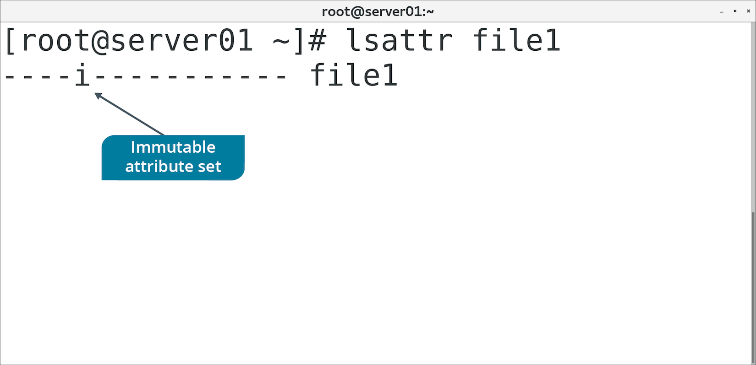
The lsattr Command (Slide 2 of 2)

Slide 44
The chattr Command
Used to change file/directory attributes.
Option | Used To
-R | Recursively change attributes of directories and their contents.
-v {version} | Set version number of file.
+i | Mark file as immutable.
-i | Remove immutable attribute.

Slide 45
Access Control Lists
A list of permissions attached to an object.
Can be used when traditional permissions don't suffice.
Enable you to assign permissions to individual users and groups.
Even when user/groups don't correspond to object's owner/group.
Example: Group 1 needs r/w/x to a directory and Group 2 needs r/x
You can get more granular with controlling access.

Slide 46
The getfacl Command (Slide 1 of 2)
Used to retrieve ACLs of files and directories.
Output shows metadata about file and permissions info.

Slide 47
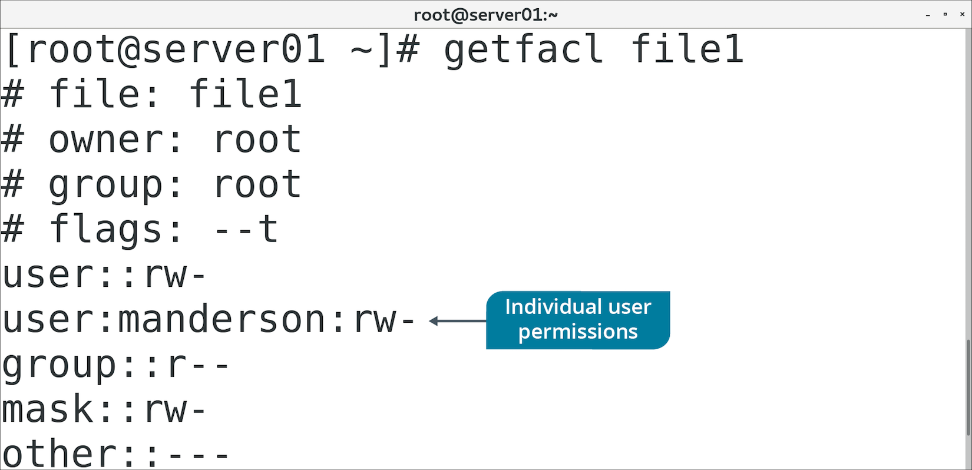
The getfacl Command (Slide 2 of 2)

Slide 48
The setfacl Command
Used to change permissions associated with file/directory ACLs.
Option | Used To
-R | Recursively set ACL options for directories and their contents.
-s | Set ACL of an object/replace existing ACL.
-m | Modify existing ACL.
-x | Remove entries from existing ACL.
-b | Remove all ACL entries.

Slide 49
Discussing Special Permissions and Attributes

Slide 50
Activity 3-6: Discussing Special Permissions and Attributes
The Marketing manager contacts you stating that the shared directory you set up for the Marketing group works, but not exactly like they'd planned. When one of the group members creates a file in the directory, the file takes on the user's user and group permissions. For example, when Linda creates a new file, the permissions are –rw-rw-r-- linda linda. The manager wants the files to all retain the mkt group permission, if possible, rather than having the users change the group themselves. What action can you take to fulfill this request?
ANSWER:
sudo chmod -R g+s /opt/marketing —By setting the SGID on the directory, every file created by anyone in the mkt group will have the mkt group ownership.

Slide 51
Activity 3-6: Discussing Special Permissions and Attributes
Gina, a member of the Marketing group, has decided that she wants her files protected so that only she can delete them, although other Marketing group members need to be able to work on and edit the files. What can she do to fix the problem of others deleting her files?
ANSWER:
You can show Gina the following command to set the sticky bit on her files: chmod +t filename.txt —This command also works on directories.

Slide 52
Activity 3-6: Discussing Special Permissions and Attributes
Ruth has searched for a solution to her problem: A few of her training documents keep getting changed or removed by system administrators removing files that haven't been accessed in excess of 180 days. She has found that a file can be made immutable, but she cannot make her own files immutable and needs your assistance. How can you make the files /home/ruth/training1_doc.txt and /home/ruth/training2_doc.txt immutable?
ANSWER:
sudo chattr +i /home/ruth/training*_doc.txt

Slide 53
Activity 3-6: Discussing Special Permissions and Attributes
A user, John, opened a ticket complaining that he has files in his home directory that he cannot remove, although they are his files and he is the user and group owner. He requests that you remove the files /home/john/billing1.txt, billing2.txt, and summary.txt. However, when you attempt to remove the files, you receive an error that you cannot remove the files as the root user. What is a possible resolution for John?
ANSWER:
You can issue the lsattr command to see if immutable flag has been set on those files. If it has, you can resolve the problem by removing the immutable flag and then removing the files: 1) sudo chattr –i /home/john/billing1.txt 2) sudo chattr –i /home/john/billing2.txt 3) sudo chattr –i /home/john/summary.txt 4) sudo rm /home/john/billing1.txt 5) sudo rm /home/john/billing2.txt 6) sudo rm /home/john/summary.txt

Slide 54
Activity 3-6: Discussing Special Permissions and Attributes
You created a shared directory for the Marketing planners, Linda and Mark, named /opt/MPlans. Their group, mplan, has exclusive access to this directory. No other user can access the directory or its contents. Linda decides that Gina needs read-only access to a single file, history.txt, inside the /opt/MPlans directory. Is this kind of restrictive access possible? If so, how can you grant it to Gina?
ANSWER:
Yes, it is possible through ACLs. First, grant Gina read and execute access to the directory: setfacl -m u:gina:rx /opt/MPlans and then, set read access to the history.txt file inside the MPlans directory: setfacl -m u:gina:r /opt/MPlans/history.txt —You can check your work by executing getfacl on the directory and its contents.

Slide 55
Activity: Configuring SGID Permissions and Sticky Bits
Group associations for /Graphics aren't applied to files created there.
A user complained about another user accidentally deleting files.
You'll correct these issues.

Slide 56
Activity: Setting the Immutable Flag on a File
You have a README in /Graphics to guide new users.
You want to ensure no one can delete this file.
You'll set the immutable attribute on the file.

Slide 57
Activity: Configuring ACLs
Marketing department needs read-only access to /Graphics
Standard permissions only define one group association.
You'll use ACLs to ensure both departments have access.

Slide 58
Topic D: Troubleshoot Permissions Issues
Exam Objectives:
4.3 Given a scenario, analyze and troubleshoot user issues.

Slide 59
Troubleshooting
The recognition, diagnosis, and resolution of problems.
Begins with identifying the problem.
Doesn't end until services are restored and problem no longer affects users.
Can take many forms.
All approaches have same goal:
Solve problem efficiently with minimal disruption.

Slide 60
Troubleshooting Models
Step-by-step approaches to troubleshooting.
Many models that vary in approach.
All models support a methodical and repeatable pattern of troubleshooting.
Example model:
Identify the problem.
Establish a theory of probable cause.
Test the theory to determine the cause.
Establish a plan of action to resolve the issue.
Implement a solution or escalate the issue.
Verify system functionality and implement preventative measures.
Document findings, actions, and outcomes.
Notes:
Teaching Tip: This generic troubleshooting model is applied throughout the course to different subject matter areas; however, this topic focuses on permissions.

Slide 61
Permissions Troubleshooting (Slide 1 of 2)
Always verify permissions with ls -al first.
Symptom | Cause and Solution
Owner of file can't view its contents. | Cause: User is not granted read access. Solution: Use chmod to grant read privileges to owner.
User can't remove directory despite having write permission. | Cause: User needs write and execute permission to modify directory. Solution: Use chmod to add execute permission to directory.
User can't enter directory despite having read access. | Cause: User needs execute permission to enter directory. Solution: Use chmod to add execute permission to directory.
User can't remove file, but has full permissions on it. | Cause: User needs write permission on containing directory. Solution: Use chmod to add write permission to directory.
User can't create files in a directory they have write/execute permission to. | Cause: Immutable flag is set on directory. Solution: As root, remove immutable flag using chattr command.

Slide 62
Permissions Troubleshooting (Slide 2 of 2)
Symptom | Cause and Solution
Root user can't modify a file. | Cause: Immutable flag is set on file. Solution: As root, remove immutable flag using chattr command.
All users can list directory contents, but only owner/group/service account should. | Cause: Read permission is set on directory for others context. Solution: Remove read permission for others context. Add service account to directory's ACL with read access.
User denied permission to execute a script they themselves created. | Cause: Execute permission is not automatically set on new files. Solution: Use chmod to add execute permission to script.
User denied permission to change a script they can execute | Cause: User needs write permission to script. Solution: Use chmod to add write permission to script.
User denied permission to execute script they have execute permission to. | Cause: User also needs read permission to script. Solution: Use chmod to add read permission to script.
All users can delete file, but should only be able to write to it. | Cause: Write/execute permissions on directories enable users to delete objects. Solution: Add sticky bit to directory.

Slide 63
Ownership Troubleshooting
Always verify ownership with ls -al first.
Symptom | Cause and Solution
User can't access file, but owner context has full permissions. | Cause: User is not owner of file. Solution: Use chown to make user owner of file.
User can't delete file, but containing directory gives full permissions to group. | Cause: Directory's group is not the same as user's group. Solution: Use chgrp to make directory's group the same as the user's.
Users can modify a file, but others context only has read permission. | Cause: File's group is set to same group that users are members of. Solution: Use chgrp to change file's group to a different group.
User creates file in shared directory, file takes on user's group ID when it should take on directory's group ID. | Cause: Files take on creating user's group ID by default. Solution: Use chmod to set SGID permission inheritance.
User creates file in shared directory, file takes on directory's group ID when it should take on user's group ID. | Cause: SGID permission is set on directory Solution: Use chmod to remove SGID permission on directory.

Slide 64
Group Membership Troubleshooting
Issues can arise if users are not in the right groups.
Use groups {user name} to check what groups a user is a member of.
Default owning group of new files may be unexpected.
Make sure expected group is user's primary group.
Use usermod to change group membership.
Consider listing all members of a group.
Not one command universal to all Linux distros.
/etc/group leaves out primary group members and other authentication.
lid and getent can provide more complete info.

Slide 65
Guidelines for Troubleshooting Permissions Issues
Follow an overall troubleshooting strategy.
Follow a step-by-step troubleshooting model.
Start by verifying an object's permissions and ownership using ls -al command.
Ensure users have permissions to work with file.
Ensure users don't have permissions beyond what they need.
Ensure objects don't have the immutable flag if they need to be modified.
Set SUID permission on an executable to run it with root permissions.
Set sticky bit when only the owner/root should be able to delete object.
Ensure objects have proper owner and group set.
Set SGID permission on directory for new files to inherit its group ID.
Use groups {user name} to verify the groups a user is a member of.
Modify group membership when necessary.
Acquire and use tools like lid and getent to view all members of a group.

Slide 66
Activity: Troubleshooting Permissions Issues
You're servicing requests at the help desk.
You need to identify permissions issues and suggest resolutions.

Slide 67
Activity 3-10: Troubleshooting Permissions Issues
Rose Stanley opened a ticket indicating that she is denied the ability to delete a directory. She confirmed with the service desk that she has write permission to the directory. What suggestion would you make to address the issue?
ANSWER:
Users also need the execute permission to remove a directory.

Slide 68
Activity 3-10: Troubleshooting Permissions Issues
Jerry Robinson received an access denied message on a file. He told the service desk that the user permissions indicate the owner has read access. What suggestion would you make to address the issue?
ANSWER:
Check to see if Jerry Robinson's account is the owner of the file, and if not, make him the owner if he should be.

Slide 69
Activity 3-10: Troubleshooting Permissions Issues
Rose Stanley received an access denied message on a file. She used the ls- l command to discover what group had been granted access to the file. She believed she should be able to access the file. What suggestion would you make to address the issue?
ANSWER:
Use the id command with Rose Stanley's account to ensure she is a member of the group specified by the file's permissions.

Slide 70
Activity 3-10: Troubleshooting Permissions Issues
Jerry Robinson cannot use the cd command to navigate into a particular directory. He told the service desk that he used ls -l to see what group is associated with the file. He also confirmed that the group is listed as having read access to the directory. He then used the id command to confirm he is a member of that group. What suggestion would you make to address this issue?
ANSWER:
Users also need the execute permission to change into a directory.

Slide 71
Activity 3-10: Troubleshooting Permissions Issues
A group with a shared directory set up by another administrator is having several problems with permissions in that directory. You've been asked to investigate. Which commands can you use to check existing permissions to help assess the current setup?
ANSWER:
1) ls -al 2) getfacl 3) lsattr —These commands will give you a good perspective on permissions, ACLs, and any attributes that have been set on the shared directory and files.

Slide 72
Activity 3-10: Troubleshooting Permissions Issues
A user complains that a script that she created and has full access to (rwxrwx---) is not executing for her. What is the problem with this script?
ANSWER:
The execute bit was removed from the script by the ACL. It's possible that the script consumed too many resources and an administrator likely removed execute access to it.

Slide 73
Activity 3-10: Troubleshooting Permissions Issues
Bob opens a ticket stating that he receives a permission denied error when trying to cd into /opt/Finance. Bob is a member of the FinanceDept group. What is the problem with Bob's access?
ANSWER:
While Bob is part of the FinanceDept group and can access all other FinanceDept group assets, he cannot use /opt/Finance because he doesn't have access via ACLs to that directory.

Slide 74
Activity 3-10: Troubleshooting Permissions Issues
The application development team created a new web app and requested that you set up a web server-accessible directory and a service account for the application. After setting up everything for the team, they opened a ticket claiming that the application cannot write logs to the log directory. What is the issue, and how can you correct it?
ANSWER:
As the root user, directories that you create are owned by root. You have to explicitly edit permissions to those directories. Change user and group ownership to the service account for any directory that the service needs to write to. The service account should have read and execute access to all other directories that it accesses. After creating a directory and subdirectories and copying files, it's generally a good practice to issue the following command: chown -R webapp:webapp /www/webapp —You can make permissions adjustments on individual directories and files as needed.

Slide 75
Activity 3-10: Troubleshooting Permissions Issues
The Graphics department requests that everyone in the company have access to company logo art to insert into emails, letterheads, and other documents. They do not want anyone outside of their group, however, to have any other access. A few days after requesting the change, other users still cannot access the files. You check permissions on the shared directory to find that the permissions are as follows: drwxrwx--- graphics GraphicsDept 4096 Dec 1 09:42 logos —What command can you issue to fix the problem?
ANSWER:
sudo chmod o+r logos

Slide 76
In what situations might you want to change the default permissions on your Linux systems?
Do you prefer to set permissions using symbolic mode or absolute mode, and why?

